Slide 1
Phase 4 Presentation
Cougar Communications

Slide 2

Progress: Where we are, and where we’ve been
We have came a long way in this phase. We have added functions to add friends and to start new chats. Our users can even talk to AI and answer almost any question you may have !

Slide 3
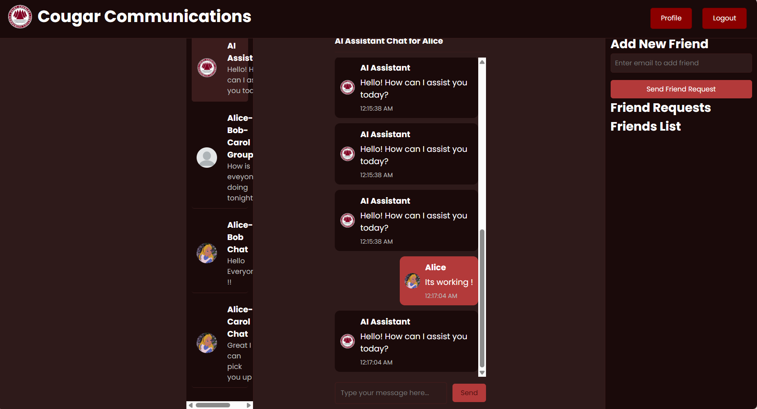
Adding and Sending Friends Request Feature

Slide 4
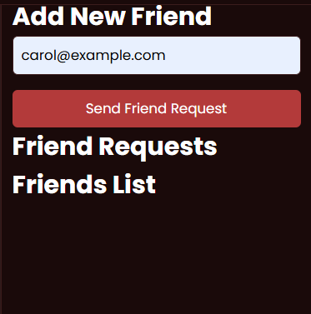
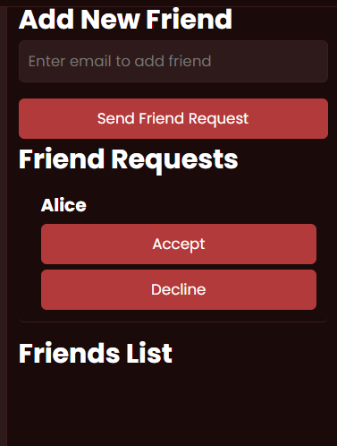
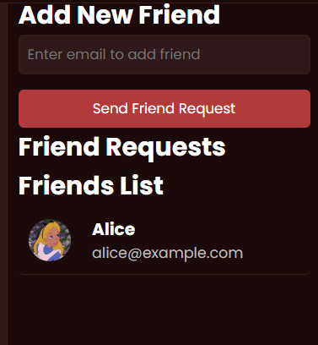
Adding and Sending Friends Request Feature
Alice Account: Send the friend request
Carol Account: Carol received the friend request
Carol Account: Carol accepted the friend request and they became friends

Slide 5

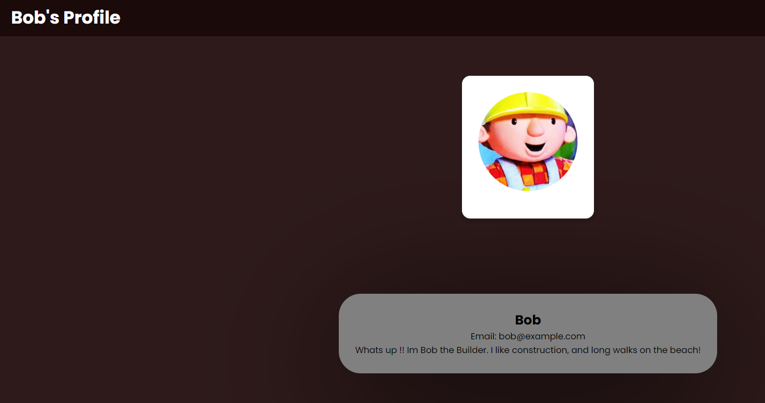
Visiting Other Users Profile Pages

Slide 6
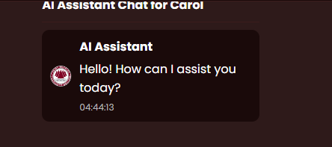
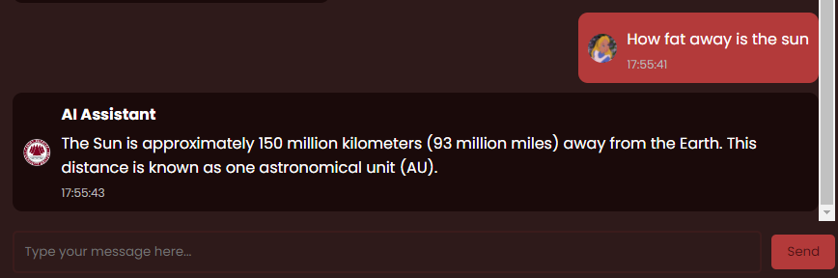
Ai Assistant

Slide 7
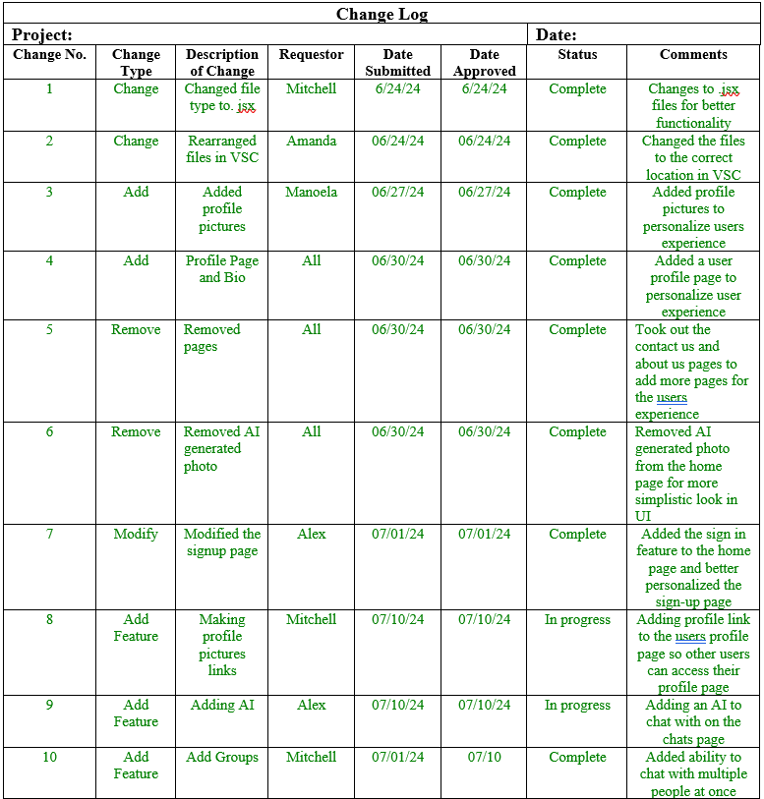
Change Log Document

Slide 8
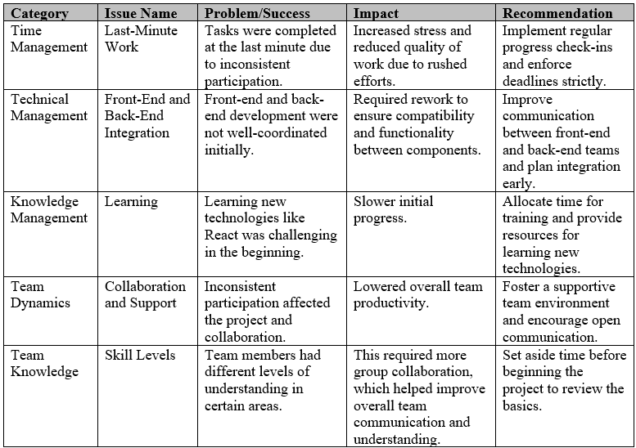
Lessons Learned

Slide 9
Live Demo

